Slide 1
Naan Mudhalvan – Salesforce Developer
TripAdvisor
E-Management
Read More
Team -06

Slide 2
ANNA UNIVERSITY REGIONAL CAMPUS COIMBATORE
Team Members:
NAME | NM ID | 32 Digits NM ID
Sriman Yaghav C (T.L) | aut710021104307 | FABBB07CAD2ADA9A32E41A976BC78491
Ragavan K | aut710021104310 | 7E1DF4E4D01B65A8C7F45671CCD86A1D
Umar Ahmed Khan A | au710021104032 | 6A8BB118261CE23A5F6493C4549B657D
Nikhil M | aut710021104321 | B42B95E24A916099F774D984E6E6403C

Slide 3

PROJECT DESCRIPTION
The TripAdvisor E-Management System is a comprehensive platform designed to manage, organize, and streamline operations for businesses in the travel and tourism industry. It provides tools for managing customer interactions, reviews, bookings, and overall business performance on TripAdvisor. The system enhances user engagement, improves service quality, and boosts business visibility through efficient e-management practices.
Key Features
User Management
Marketing and Visibility
Performance Analytics

Slide 4
Objectives
Business Goal
Specific Outcomes
Improve Customer Experience: Use Salesforce to make travel bookings easier, give better recommendations, and offer quick support.
Handle Reviews Automatically: Track and respond to TripAdvisor reviews quickly to keep customers happy.
Use Data to Improve: Understand booking trends and customer needs to make smarter business decisions.
Save Time with Automation: Automate tasks like updating travel plans and sending booking confirmations to reduce mistakes.
Custom Salesforce Objects: Create objects for managing travel listings, customer bookings, reviews, and feedback within the CRM.
Automated Workflows: Implement Apex triggers and Flows to automate tasks like review monitoring, booking confirmations, and discount calculation.
Remainder Mails: Flight reminder emails sent automatically 24 hours before flight departure, improving customer satisfaction.
Analytics Integration: Use Salesforce reports and dashboards to analyze booking trends, customer preferences, and review ratings in detail

Slide 5
PROJECT FLOW
Salesforce
Object
Fields & Relationships
Flow
User Adoption
OWD Settings
Lightning App
Tabs
Apex Trigger
Apex Scheduled
Reports
Dashboards

Slide 6
Key Features and Concepts
1. Custom Objects:
The system is designed with interconnected objects that represent various key components of a travel and booking platform.
Each object encapsulates specific data and functionalities, contributing to a seamless user experience
2.Apex Triggers:
Ensures automatic updating of hotel data whenever food options are added or modified.
Example: Updating the total count of food options for each hotel.
3.Flows:
Automates customer discount application based on purchase amounts.
Example: Full discounts for purchases exceeding 3000 and partial discounts for purchases between 1500 and 3000.
4.Schedulable Apex Classes:
Handles scheduled email notifications for customers regarding upcoming flights.
Example: Sends email reminders 24 hours before the scheduled departure.
5.Reports and Dashboards:
Tracks customer discounts, flight bookings, and hotel occupancy rates for operational insights.

Slide 7
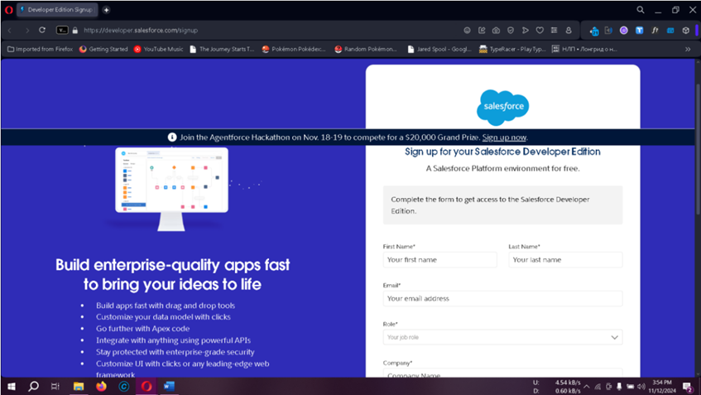
Developer Account Creation
Creating a Salesforce developer account provides access to CRM features and customization tools necessary for the setup.
1. Sign-Up: Complete the Salesforce Developer Sign-Up with details such as name, email, role, and company.
2. Account Activation: Verify via email, set up a password, and access the Salesforce setup.

Slide 8
Creating Objects in Salesforce
Objects are tables within Salesforce for data storage:
Standard Objects: Default Salesforce objects (e.g., Accounts, Contacts).
Custom Objects: User-defined objects for specialized data, like Automobile Information and Invoice.

Slide 9
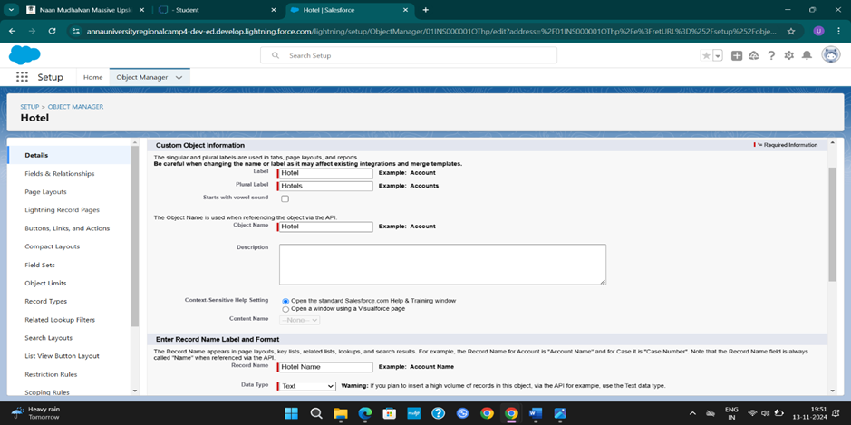
Custom Objects: Create object for Hotel, Customer, Flight, Food Option using Object
manager and Details Customer Object Information.

Slide 10
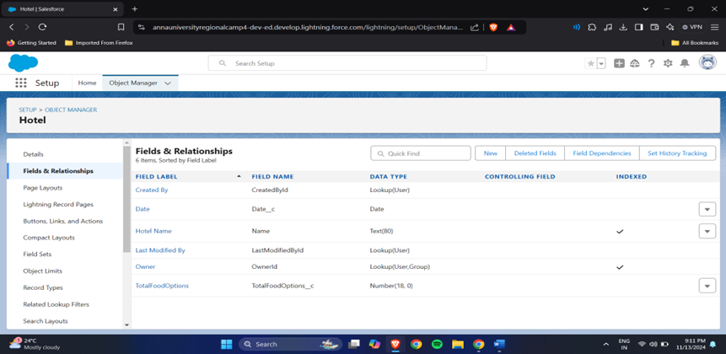
Fields & Relationships: Creating fields and defining relationships for the object is crucial for organizing and retrieving information efficiently

Slide 11
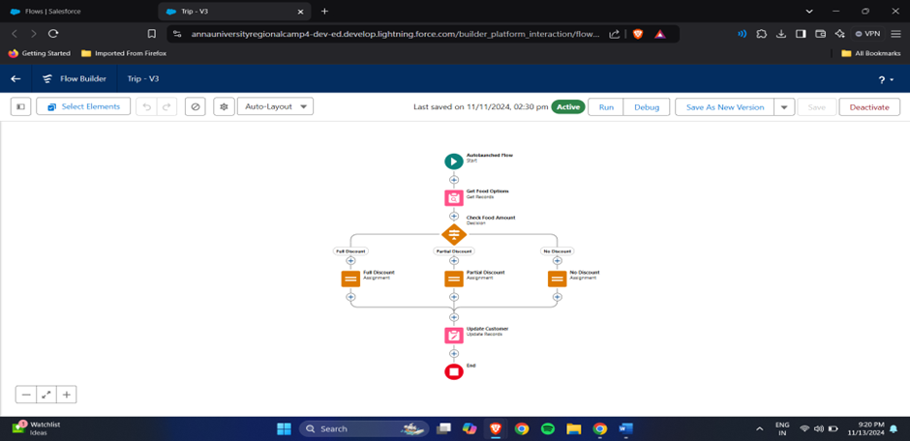
Flow: Flow Variables are temporary placeholders used within a process or workflow to store and manipulate data

Slide 12
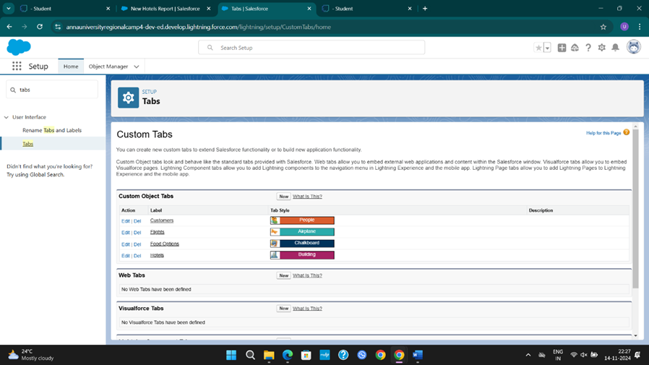
Tabs: Tabs in Salesforce provide a user interface for managing and viewing records.

Slide 13
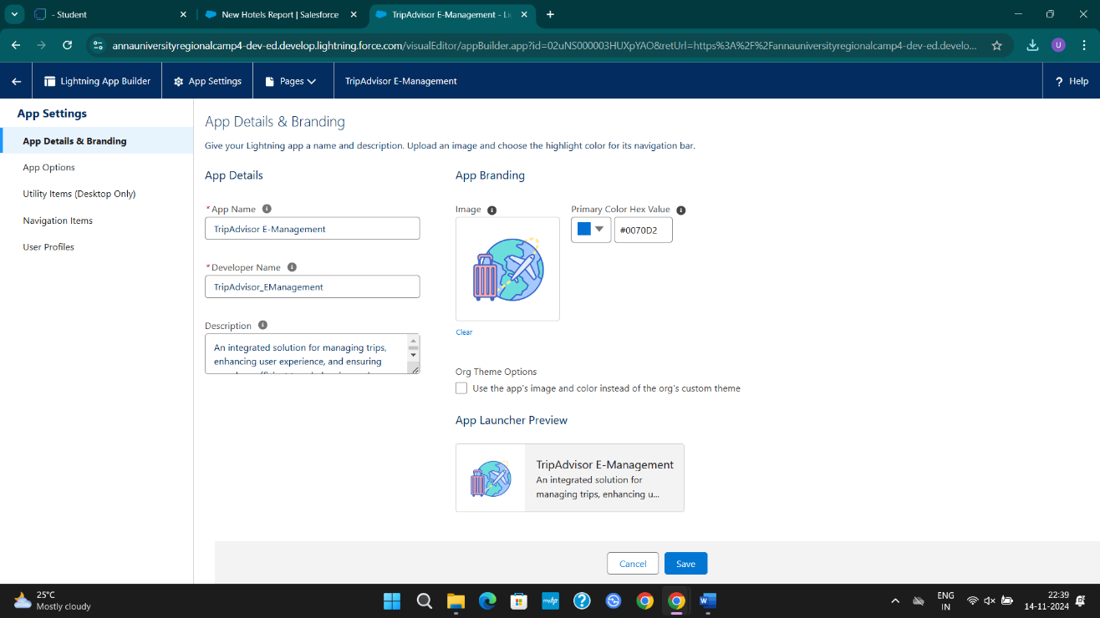
Lightning app: It gives users access to sets of objects, tabs, and other items all in one convenient bundle in the navigation bar.

Slide 14
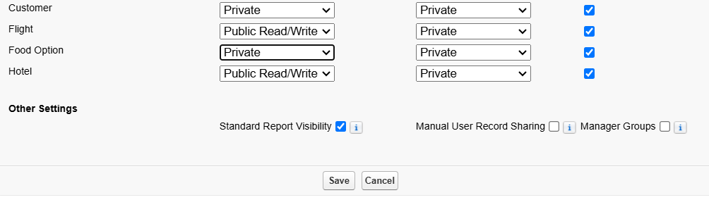
OWD Setting:
Organization-Wide Defaults (OWDs) are the foundational security settings that determine access to data across the system.
Go to Set Up → in the Quick Find box type Sharing Settings → click on it.
Click Edit in the Organization-Wide Defaults area

Slide 15
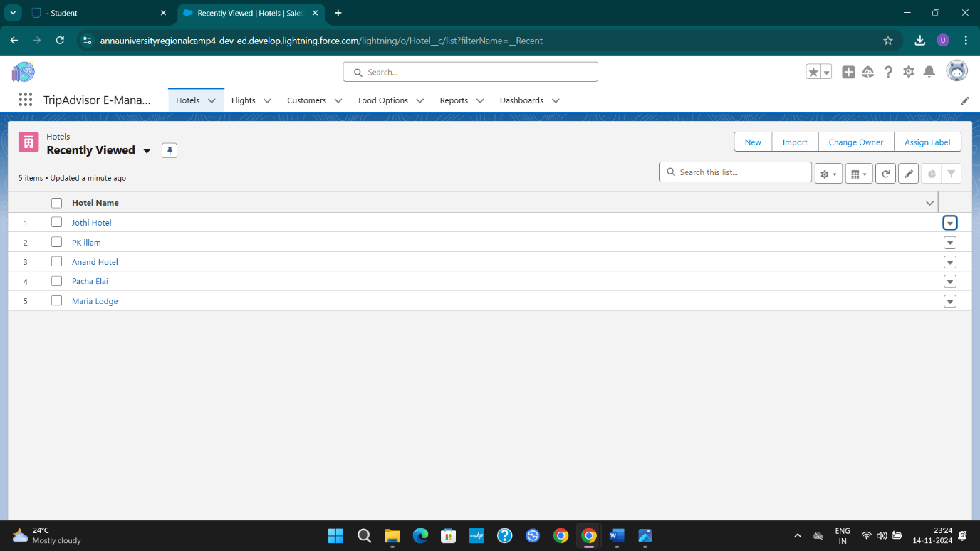
User Adoption: Handling user management tasks such as creating and editing user accounts, resetting passwords and adding them to your TripAdvisor E- Management platform
Click on App Launcher on the left side of the screen.
Search TripAdvisor E- Management System & click on it.

Slide 16
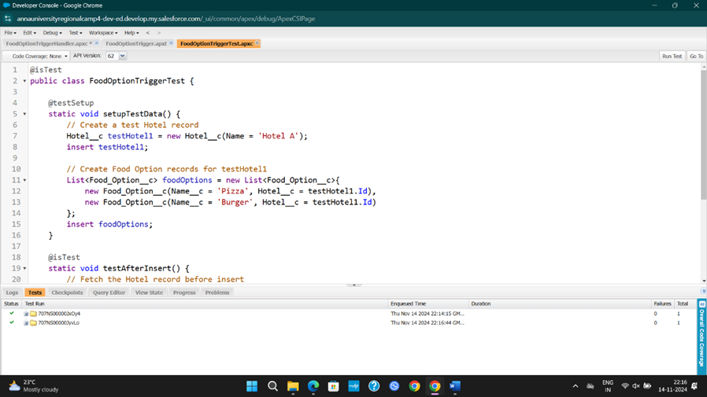
Apex Trigger: A "Test Trigger case run successfully" means that a trigger (an automated process or function) was executed, and it completed without errors or failures.

Slide 17
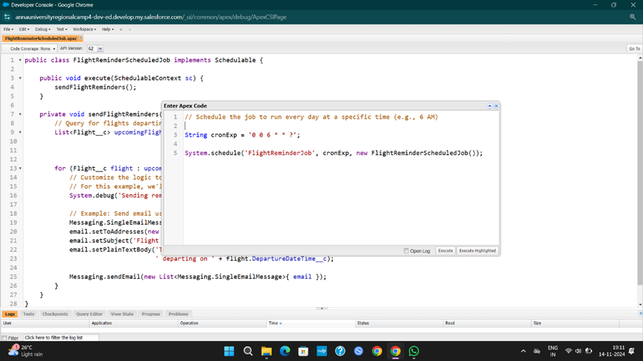
Apex Schedule: A Scheduled Job Code is a task or process that runs automatically at predefined times or intervals.

Slide 18
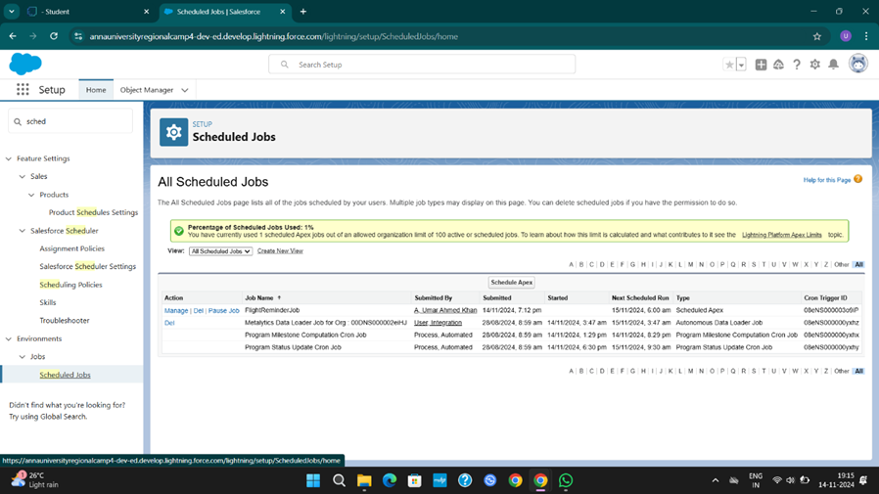
All job scheduled has been updated:

Slide 19
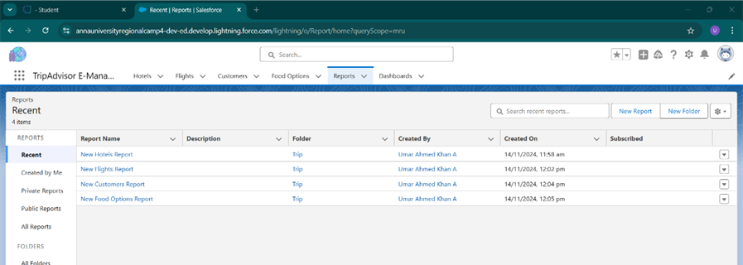
Reports:
You can examine your Salesforce data in almost infinite combinations, display it in easy, understandable formats, and share the resulting insights with others
Go to the app → click on the reports tab
Click New Report
Select report type
Create a report with report type: “Hotel, Flight, Customer, Food Option”.

Slide 20
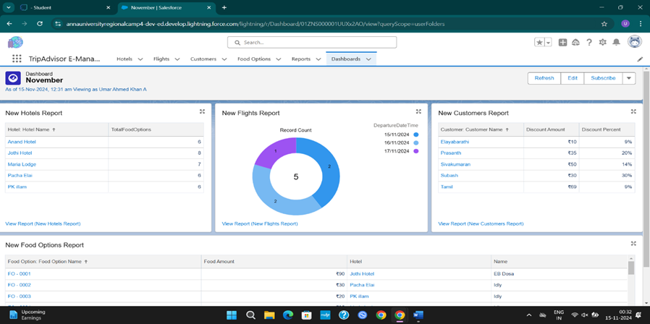
Dashboard:
Dashboards provide a visual summary of real-time data
Go to the app → click on the Dashboards tabs.
Give a Name and click on Create.
Select add component.
Select a Report and click on select.

Slide 21

Key Scenarios Addressed by Salesforce in the
TripAdvisor E-Management Implementation Project:
Booking Management: Tracks available travel packages, accommodations, and activities, updating automatically when bookings are confirmed.
Automation of Tasks: Generates invoices and sends booking confirmations automatically once reservations are finalized.
TripAdvisor
E-Management
Customer Insights: Provides detailed dashboards and reports to monitor booking trends, customer preferences, and team performance.
Data Accuracy: Ensures users cannot overbook accommodations or skip required fields when creating or updating trip details.

Slide 22

Thank You
-

